Slide 1


SMART INDIA HACKATHON 2026
TITLE PAGE
Problem Statement ID –
Problem Statement Title-
Title-
Name-

Slide 2











DRISHTI
PROPOSED SOLUTION
HOW IT ADDRESSES THE PROBLEM
INNOVATION & UNIQUENESS
MoSJE Oversight & Web Dashboard
Define Policy, Monitor
Eliminates Fake Reporting Tamper-proof Data
Lightweight Al
Efficient, Low-Bandwidth Vision
Central Al Hub & Automation
Data Process, Random Assign
Prevents Collusion
Random Assignments
Zero-Trust Evidence Hardware-Verified Data
Field App & Live Feeds
Capture Geo- Evidence, Live VC
Overcomes Bottlenecks
Efficient Scalability
Analytics & Insights Detect Anomalies, Verify Attendance
Automates Compliance
24/7 AI Auditing
Unified Ecosystem Centralized Monitoring Platform

Slide 3
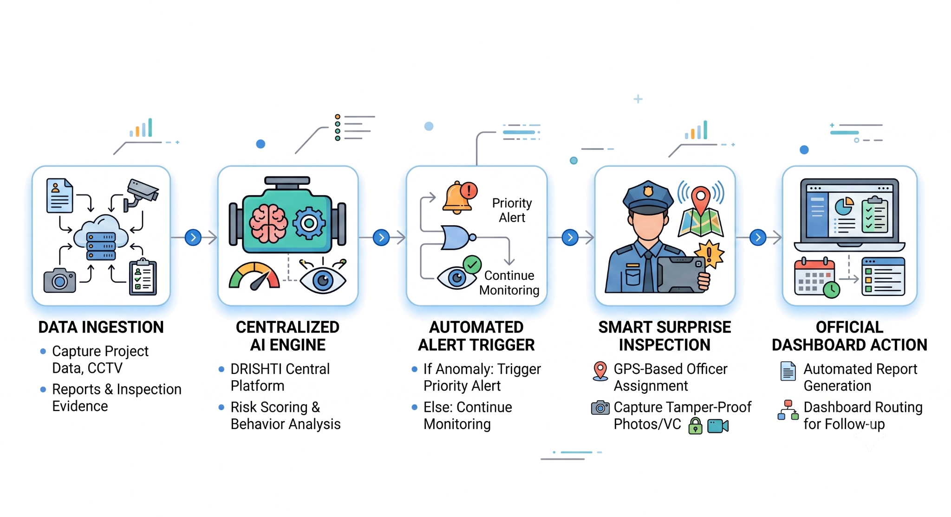
TECHNICAL APPROACH
METHODOLOGY & FLOW
TECH STACK

Slide 4
Technical Approach — DRISHTI
🛠️ Tech Stack & Tools
Frontend & Maps Flutter / React Native (Cross-platform), GPS + Google Maps API
Backend & DB Python (FastAPI) + Node.js APIs, PostgreSQL & Firebase
AI & Computer Vision OpenCV, YOLO, Scikit-learn (Anomaly, attendance & activity analytics)
Surveillance & Comm RTSP/IP Camera, WebSockets (Live CCTV), WebRTC (Secure VC)
Security & Deployment JWT, RBAC, AES-256 encryption, Docker + Cloud/On-Premise
🔄 Methodology Flow
1. Data Ingestion & Live Feeds Capture Project Data, CCTV, Reports & Inspection Evidence.
2. Centralized AI Engine DRISHTI Central Platform performs risk scoring & behavior analysis.
3. Automated Alert Trigger If anomaly is detected, trigger priority alert; else continue monitoring.
4. Smart surprise Inspection Assign nearby field officers via GPS. Capture tamper-proof photos/VC.
5. Official Dashboard Action Automated report generation and dashboard routing for follow-up.
⚙️ Prototype & Principle
Prototype Workflow
App ➔ API Gateway ➔ AI Engine ➔ DB ➔ Dashboard
Demonstrates role-based login, GPS-based allocation, evidence capture, anomaly alerts, and automated reporting.
Core Operating Principle
MONITOR
⬇
DETECT
⬇
VERIFY
⬇
REPORT
⬇
ACT

Slide 5
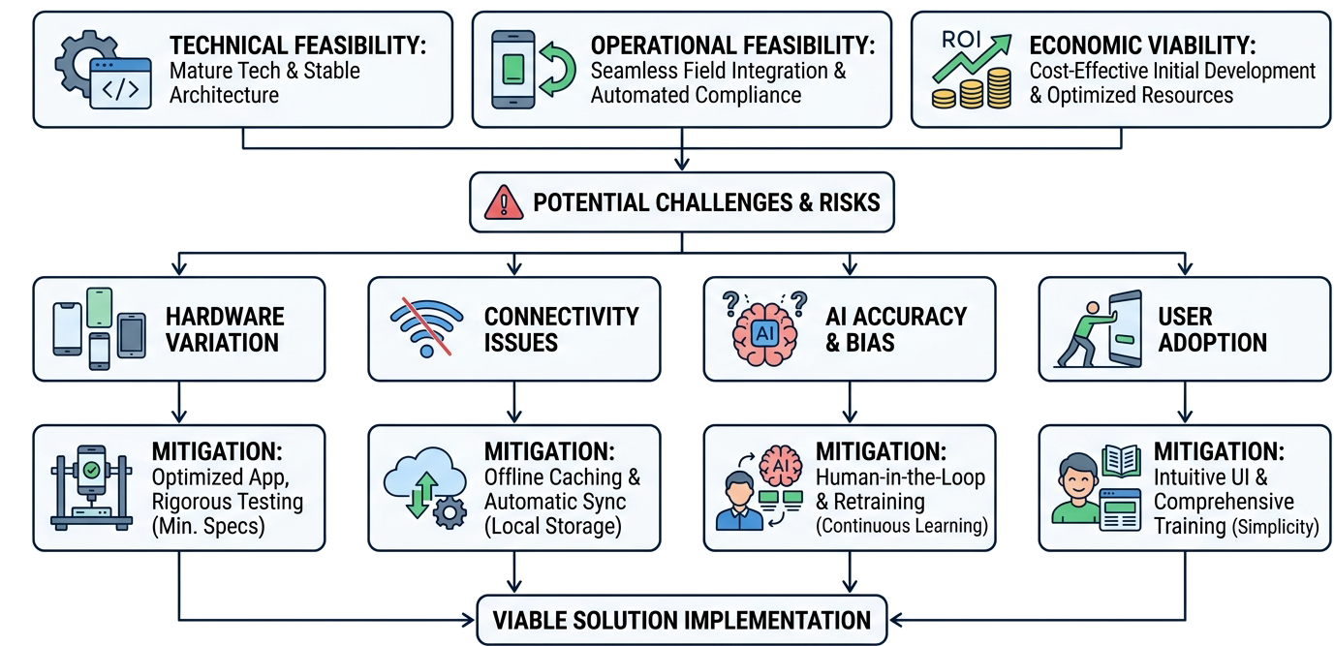
FEASIBILITY & VIABILITY

Slide 6
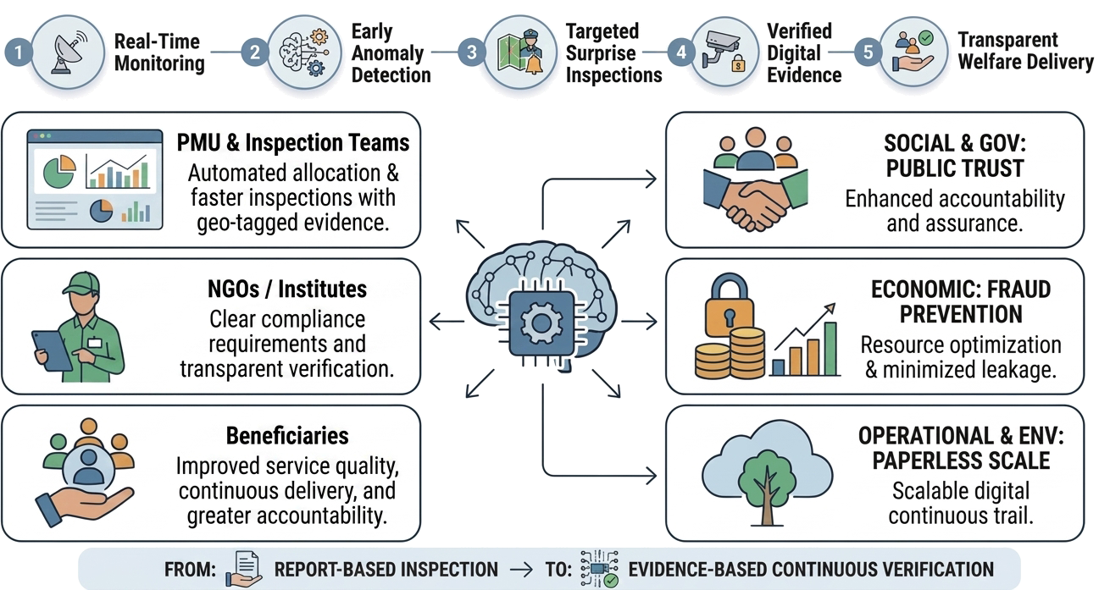
IMPACT & BENEFITS

Slide 7
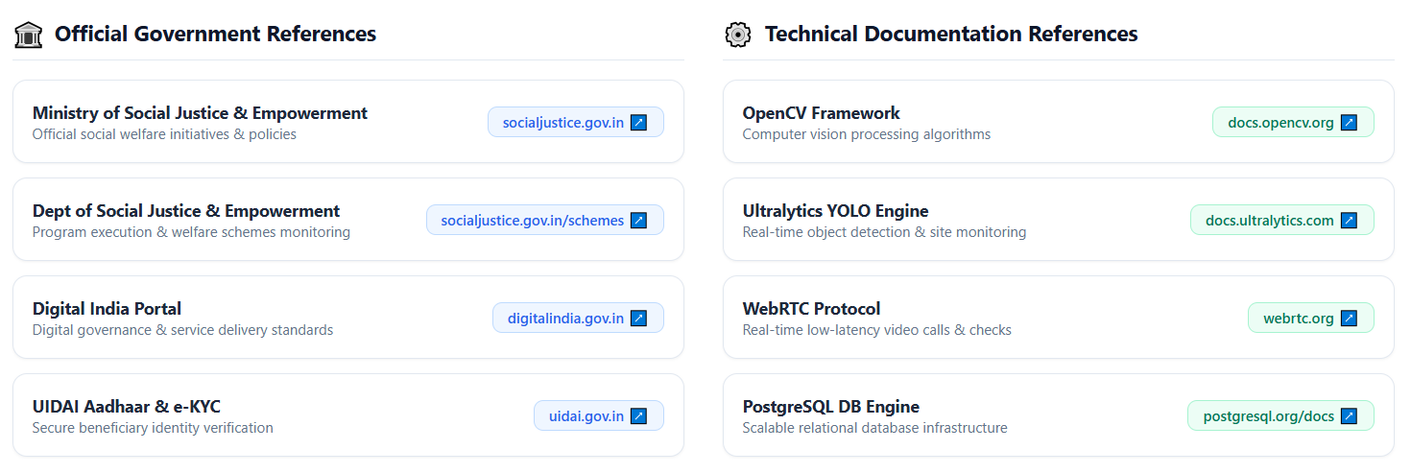
REFERENCES & RESEARCH — DRISHTI
https://socialjustice.gov.in/
https://docs.opencv.org/
https://socialjustice.gov.in/
https://socialjustice.gov.in/schemes
https://docs.ultralytics.com/
https://digitalindia.gov.in/
https://webrtc.org/
https://uidai.gov.in/
https://postgresql.org/docs

